Slide 1
“Commuting graph associated with algebraic structure”
Special Project (MATH F491)

Slide 2
Presented by-
Vishesh Garg - 2016B4A70611P
Aditya Tulsyan - 2017B4A70740P
Supervised by: Dr Jitender Kumar

Slide 3
ABOUT THE PROJECT

Slide 4
PRE-MID-SEMESTER WORK

Slide 5
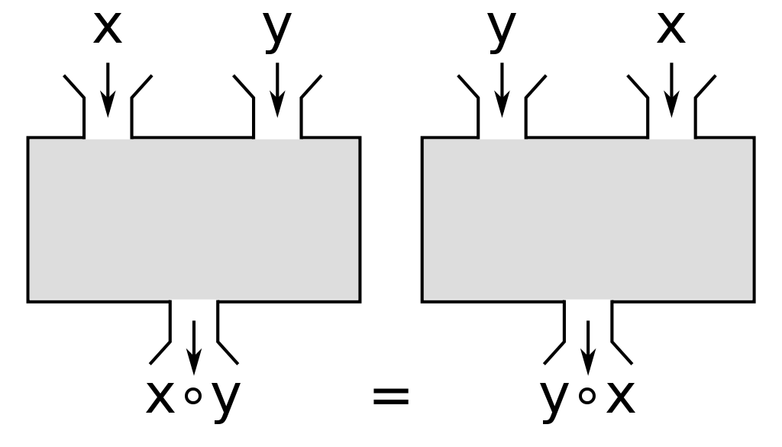
Commuting graph for group structure V_{8n}
Commutative property: Two elements (x and y) of any group G are said to commute iff x o y = y o x where “o” is the binary operation associated with the group.

Slide 6
Commuting graph for group structure V_{8n}
Commuting Graph: Given a finite group G and a subset X of G, the commuting graph of G on X, denoted by C(G,X) is the graph that has X as its vertex set with x, y ∈ X joined by an edge whenever x ≠ y and x o y = y o x (i.e. elements commute w.r.t. the binary operation o)
.

Slide 7
Commuting graph for group structure V_{8n}
V_{8n} group
The group V_{8n} is defined as:
V_{8n}= < a, b | a^{2n} = b⁴ = e, ba = a⁻¹ b⁻¹ , b⁻¹ a = a⁻¹ b >
Note that |V_{8n}| = 8n.
Elements of V₈ = { e, a, b, b², b³, ab, ab², ab³ } (for n = 1)

Slide 8
Since, ba = a⁻¹b⁻¹ and b⁻¹a = a⁻¹b, one can observe that:
b²a^{i} = a^{i}b²
ba^{i} = a^{2n-i}b; if i is even
a^{2n-i}b³; if i is odd
b³a^{i} = a^{2n-i}b³; if i is even
a^{2n-i}b; if i is odd
Thus, every element of V_{8n}\ <a> is of the form a^{i}b^{j} for some i, j, where 1 ≤ i ≤ 2n and 1 ≤ j ≤3

Slide 9
Commuting graph for group structure V_{8n}
Center of a group: The center of a group is the set of elements which commute with every element of the group. It is equal to the intersection of the centralizers of the group elements.
Examples:
The center of an abelian group, G, is all of G.
The center of a nonabelian simple group is trivial.

Slide 10
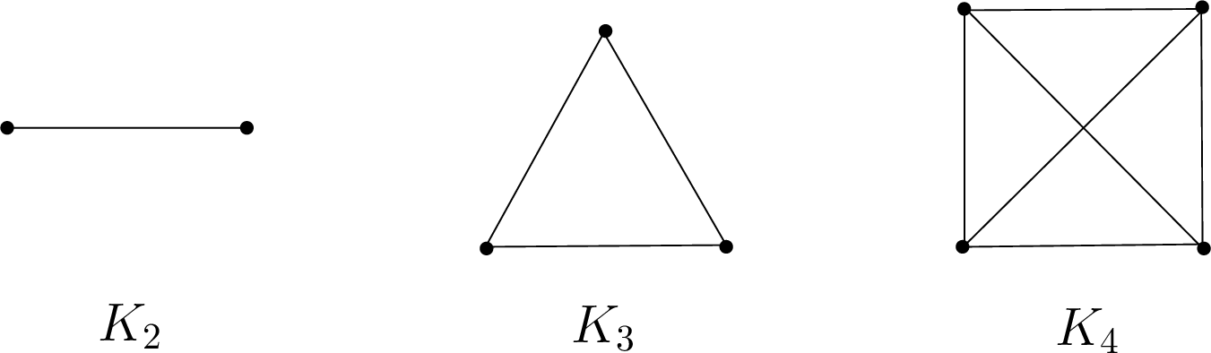
Center of group V_{8n}
Case1: if n is odd
Z_{8n} = { e, b² }
(Where e is the identity element)
e b²
K₂
V_{8n-2} = V_{8n} ~ Z_{8n}
V_{8n-2}
K₂ : Complete graph with two nodes

Slide 11
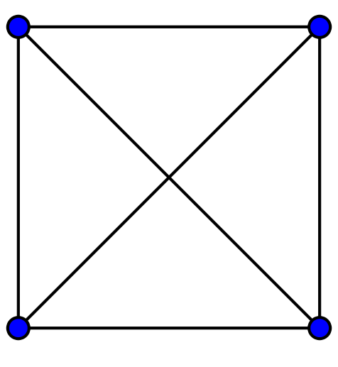
Case2: if n is even
Z_{8n} = { e, b² , a^{n}, a^{n}b² }
(Where e is the identity element)
e b²
V_{8n-4}= V_{8n} ~ Z_{8n}
K₄
a^{n} a^{n}b²
V_{8n-4}
K₄ : Complete graph with four nodes

Slide 12
POST-MID SEMESTER

Slide 13
Commuting graph for group structure V_{8n}
The neighbourhood of a vertex: The neighbourhood of a vertex v in a graph G is the subgraph of G induced by all vertices adjacent to v, i.e., the graph composed of the vertices adjacent to v and all edges connecting vertices adjacent to v. (N[x])
N[e] = V_{8n} (for both n even and odd)
(Where e is the identity element)

Slide 14
Case 1: n is ODD
Center of V_{8n} for n odd: Z_{8n} = { e, b² }
N[e] = V_{8n}
N[b] = {e, b, b², b³}
N[b²] = V_{8n} ( Since, b² ∈ Z_{8n})
N[b³] = {e, b, b², b³}
N[a^{i}b] = { e, b² } U {a^{j}b} U {a^{j}b³}
N[a^{i}b²] = { e, b² } U {a^{j}} U {a^{j}b²}
N[a^{i}b³] = { e, b² } U {a^{i}b³} U {a^{i}b}
N[a^{i}] = { e, b² } U { a^{i} } U { a^{i}b² }

Slide 15
Case 2: n is EVEN
Center of V_{8n} for n even: Z_{8n} = { e, b² , a^{n}, a^{n}b² }
N[e] = V_{8n}
N[b] = {e, b, b², b³, a^{n}b, a^{n}b², a^{n}b³, a^{n}}
N[b²] = V_{8n} ( Since, b² ∈ Z_{8n})
N[b³] = {e, b, b², b³, a^{n}b, a^{n}b², a^{n}b³, a^{n} }
N[a^{i}b] = { e, b², a^{n}, a^{n}b² } U {a^{j}b} U {a^{j}b³}
N[a^{i}b²] = V_{8n}; for i = n
= { e, b² } U {a^{j}} U {a^{j}b²}; otherwise
N[a^{i}b³] = { e, b², a^{n}, a^{n}b² } U {a^{j}b} U {a^{j}b³}
N[a^{i}] = V_{8n}; for i = n
= { e, b², a^{n}, a^{n}b³ } U { a^{j}b² } U { a^{j} }; otherwise

Slide 16
PROPERTIES OF V_{8n}
Edge connectivity:
Edge connectivity: The minimum number of edges whose detention from a graph disconnects the graph.
Case 1: n even Edge connectivity = 4
Case 2: n odd Edge connectivity = 3

Slide 17
PROPERTIES of V_{8n}
Vertex connectivity
Vertex connectivity: The minimum number of vertices whose deletion from a graph disconnects the graph. Also referred to as point connectivity.
Case 1: n even
Vertex connectivity = 4
Case 2: n odd
Vertex connectivity = 2

Slide 18
PROPERTIES of V_{8n}
Clique Number
Clique number: The size of the largest complete subgraph(clique) in the given graph.
Clique number = 4n (for both odd and even)
Independence Number
Independent set: A set of vertices of the graph, no two of which are adjacent.
Independence number: The cardinality of the largest independent vertex set.
Case 1: n even
Independence number = 2n -1
Case 2: n odd
Independence number = 2n+1

Slide 19
PROPERTIES of V_{8n}
Vertex covering number
Vertex covering number: The size of the minimum vertex cover (A vertex cover is a set of vertices such that each edge of the graph is incident to at least one vertex of the set)
Vertex cover number = 6n (for both odd and even)
Matching Number
Matching number: The size of maximum vertex cover (A vertex cover is a set of vertices such that each edge of the graph is incident to at least one vertex of the set)
Case 1: n even
Matching number = 4n-2
Case 2: n odd: 4n-1
Matching number = 4n-1

Slide 20
Properties of V_{8n}
Edge cover number
Edge covering number: The size of the minimum edge cover (An edge cover of a graph is a set of edges such that every vertex of the graph is incident to at least one edge of the set)
Edge cover number = 4n (for both n even and odd)
Eulerian Graph
Eulerian graph: An Eulerian trail (or Eulerian path) is a trail in a finite graph that visits every edge exactly once. Similarly, a Eulerian circuit or Eulerian cycle is a Eulerian trail that starts and ends on the same vertex. A Eulerian graph is a graph that contains a Eulerian cycle.
Result: V_{8n} is not a Eulerian Graph

Slide 21
References
Panda, Ramesh & Dalal, Sandeep & Kumar, Jitender. (2020). On the enhanced power graph of a group.
A. Iranmanesh and A. Jafarzadeh (2008). On the commuting graph associated with the symmetric and alternating groups.
Vahidi, Javad & Talebi Rostami, Ali. (2010). The commuting graphs on groups and. Journal of Mathematics and Computer Science. 11. 123-127.
Torktaz, M. & Ashrafi, Ali. (2018). Spectral properties of the commuting graphs of certain groups. AKCE International Journal of Graphs and Combinatorics. 16. 10.1016/j.akcej.2018.09.006.

Slide 22
THANK YOU

